Slide 1
Fashion: a Cultural Perspective
Cindy Lu

Slide 2

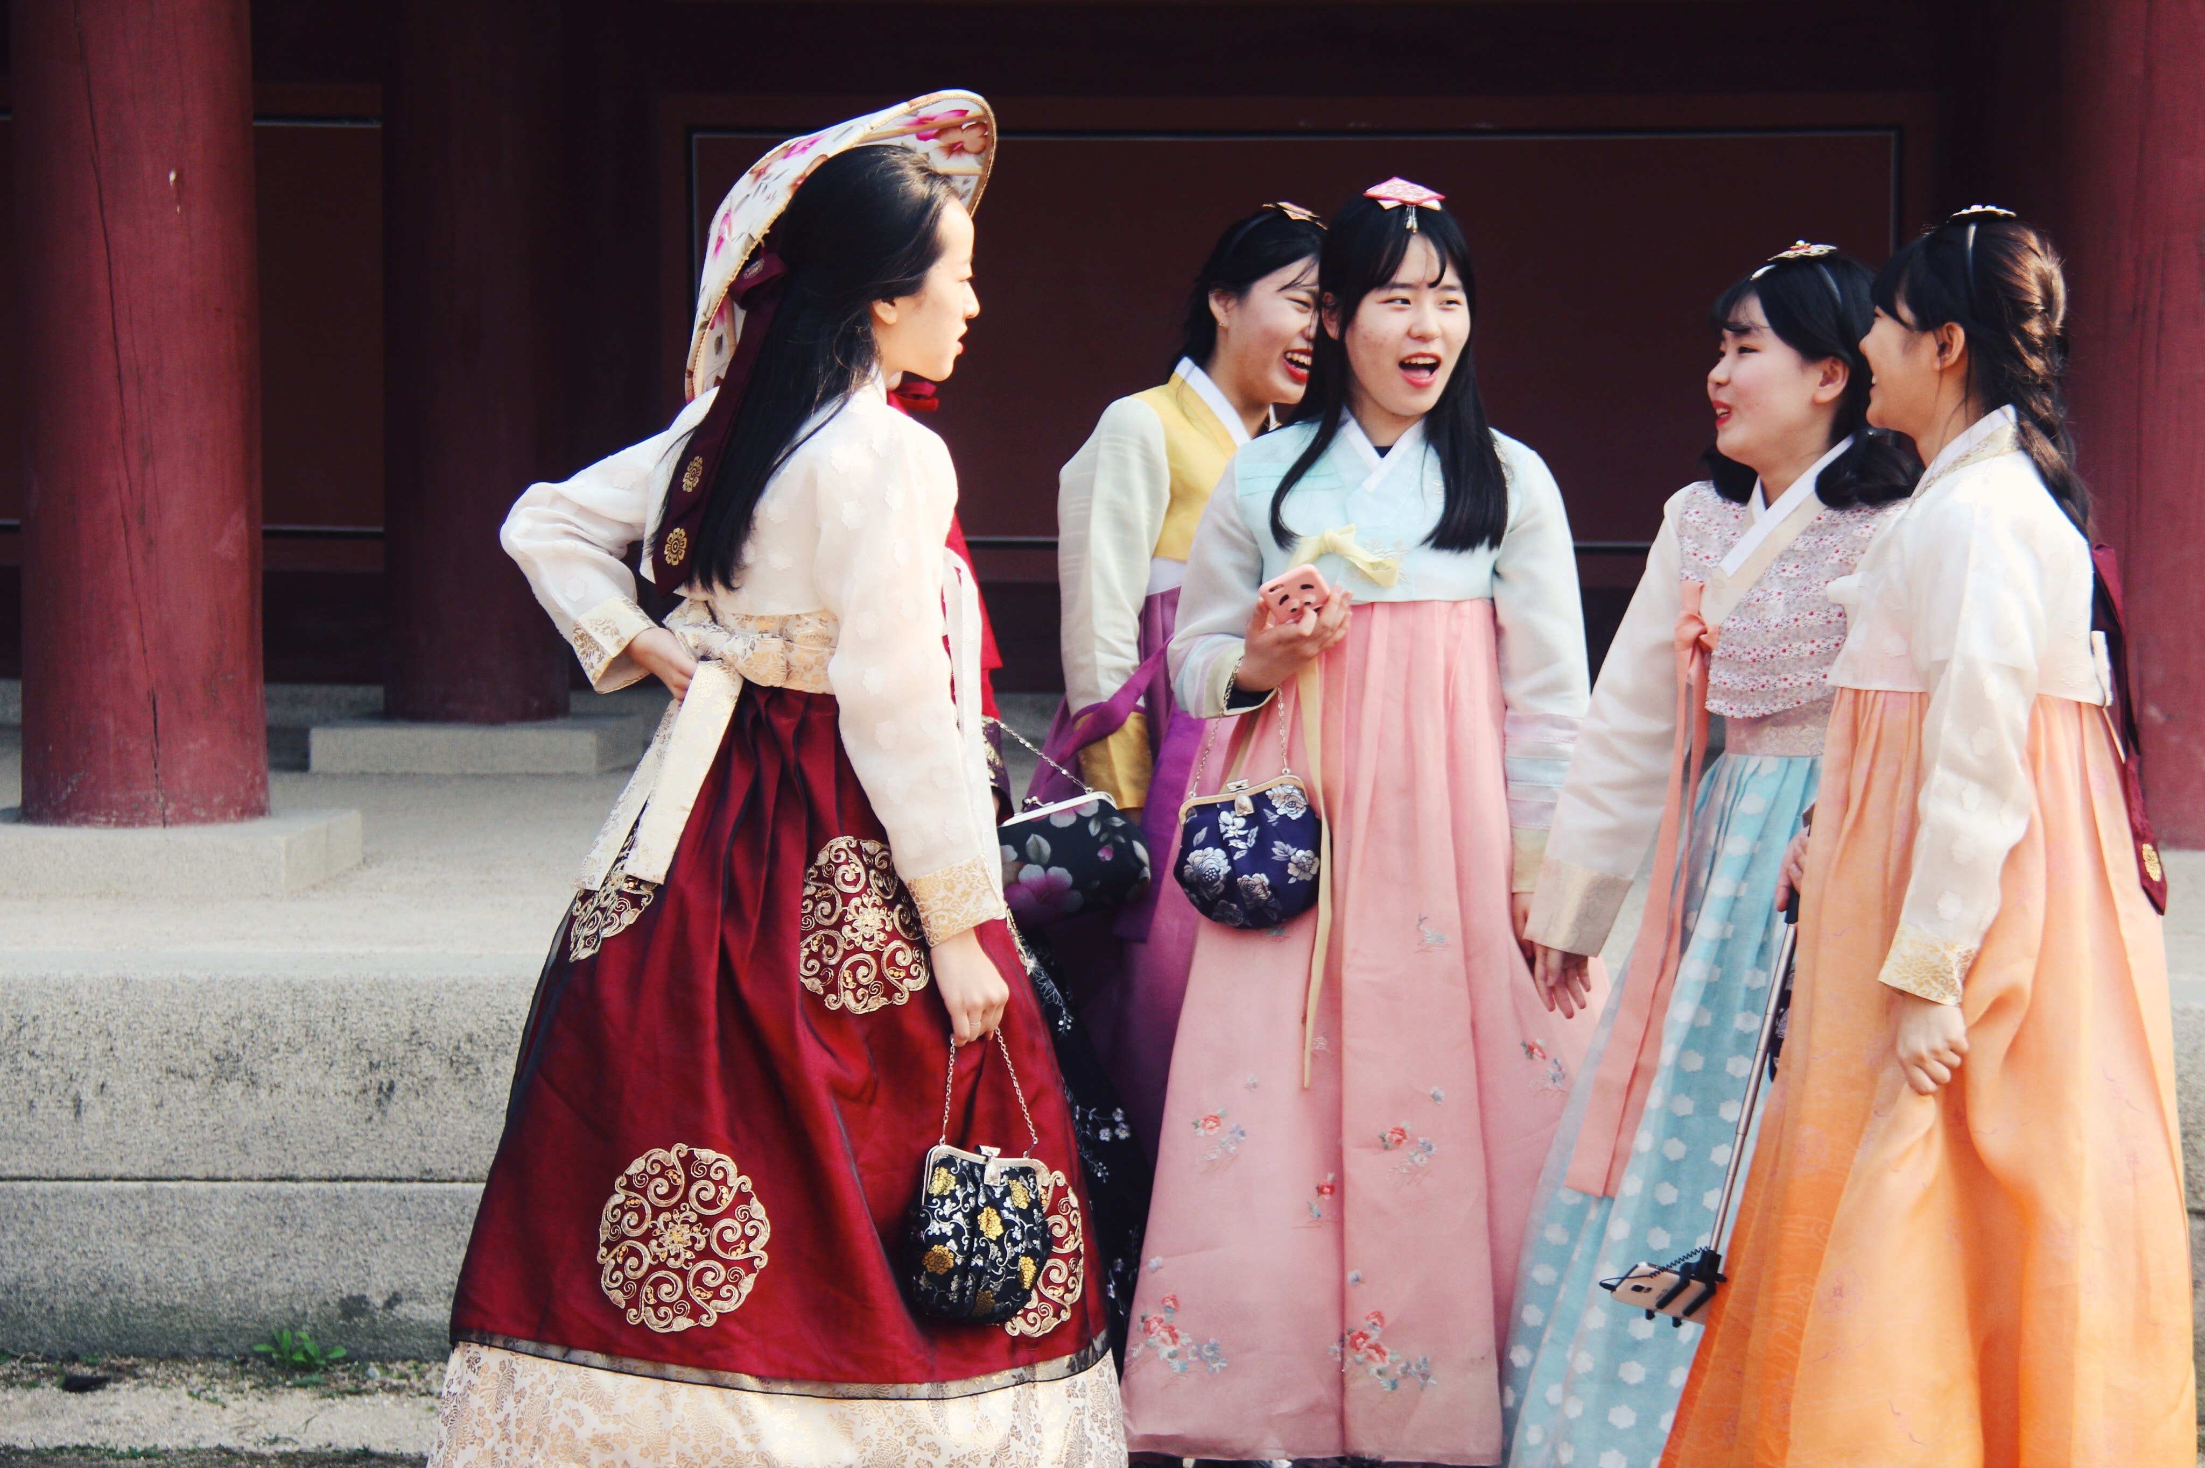

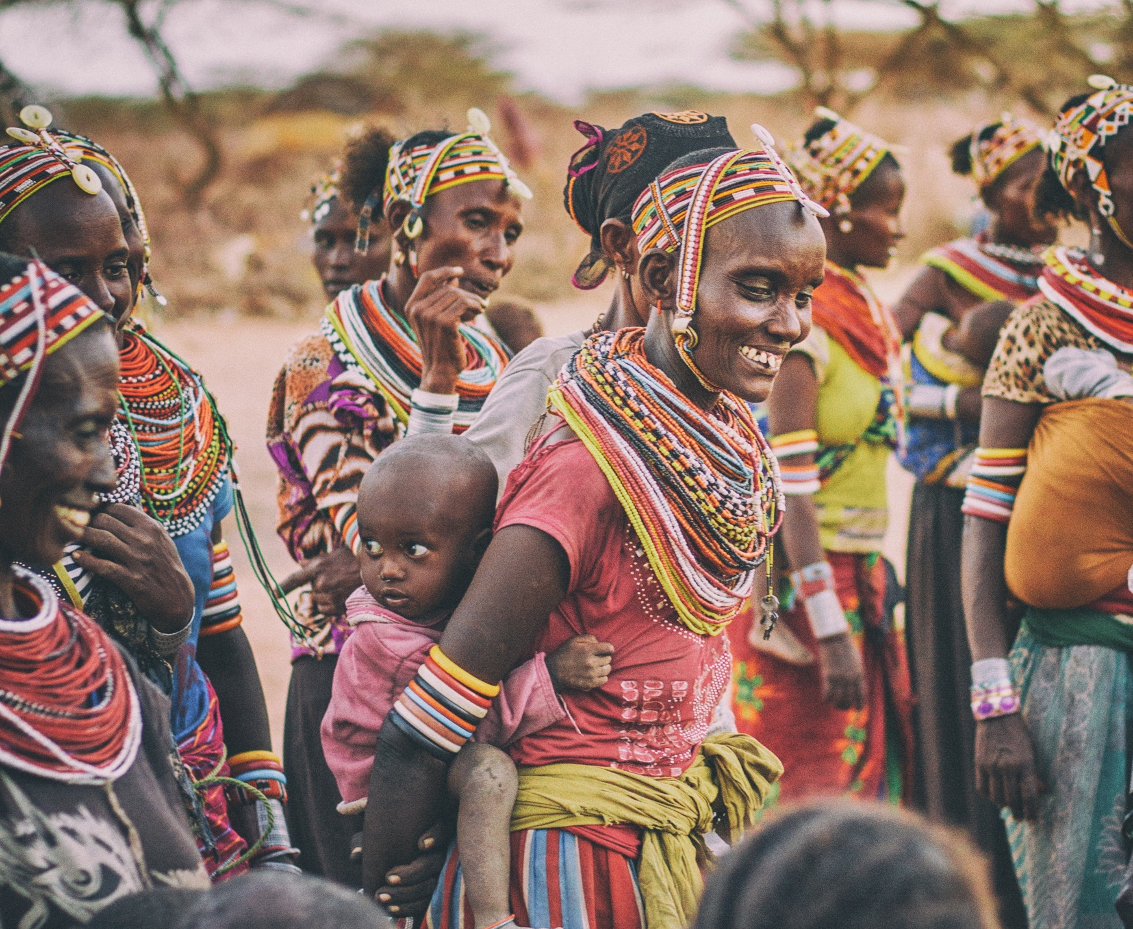

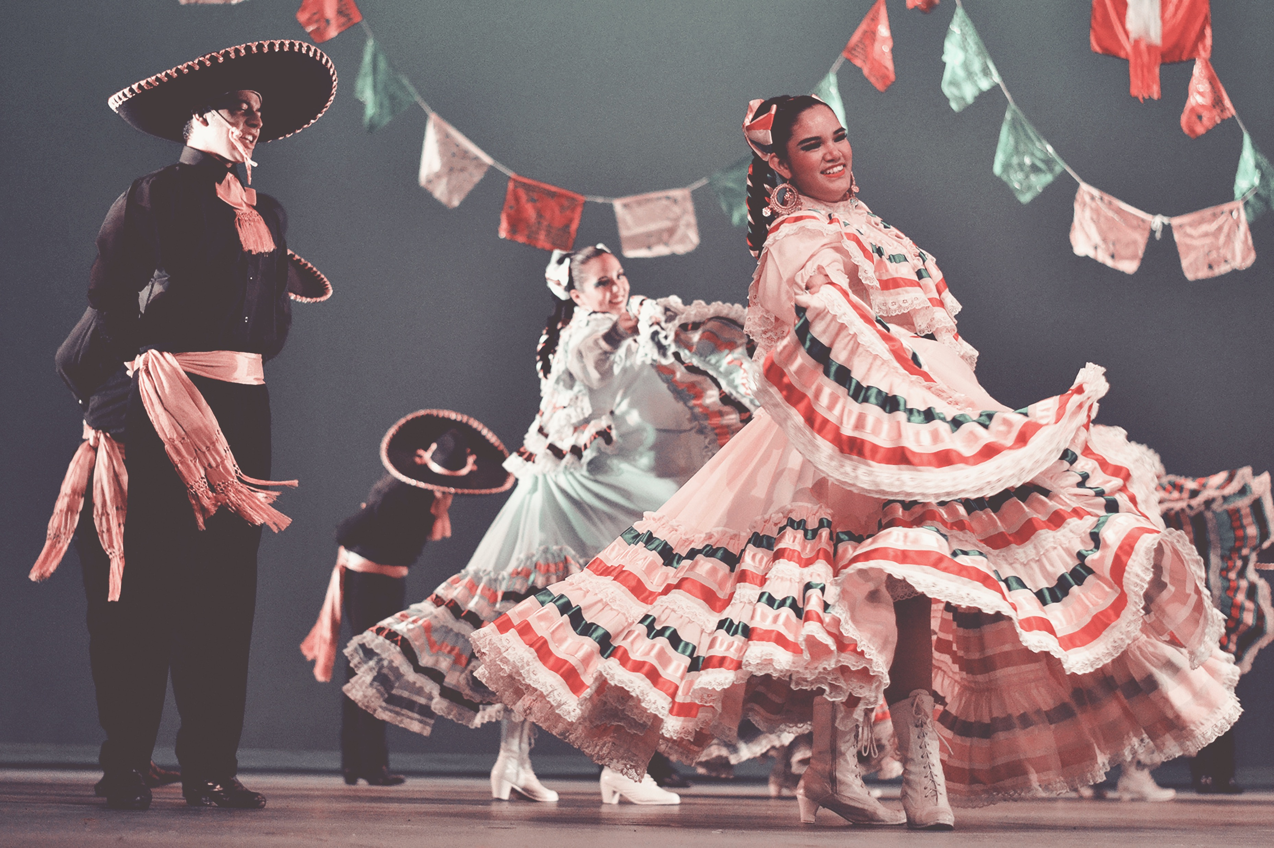
WHAT
Interactive catalog of the national costumes of countries around the world
WHO
Anyone interested in fashion, culture, and/or history
WHY
To highlight cultures around the world
https://unsplash.com/photos/7k91OUDYAQ0
https://unsplash.com/photos/Zex7MmwCzMc
https://unsplash.com/photos/U5UJaFbgT0w
https://unsplash.com/photos/_HzlOHmboSk

Slide 3
HOW IT WORKS
Users select country of choice from map
Page expands to display selected country
Users click through as information pop ups
TECHNOLOGIES
jQuery
Animations
Manipulating photos
Leaflet
Maps

Slide 4
INSPO
Image animation & pop-ups
http://fingfx.thomsonreuters.com/gfx/rngs/AWARDS-OSCARS/0100320J4L6/index.html
Home page
By country: https://www.weekendavisen.dk/vm-bolden#/
By map: http://www.mathis-biabiany.fr/
One-page scroll
https://noformat.com/

Slide 5
progress
CHECK
CHALLENGES
Information on countries’ cultural wear
Examples: Mexico, Japan, India, Kenya, Spain
Photo animation
Consistency in visuals
TO DO
Compile photos and information

